Slide 1

Black Friday Sale Analysis

Slide 2

A retail company wants to understand the customer purchase behavior (specifically, purchase amount) against various products of different categories. They have shared purchase summary of various customers for a selected high-volume products from last month. They want to build a model to predict the purchase amount of customer against various products which will help them to create personalized offer for customers against different products.
INTRODUCTION

Slide 3

Dataset
Data.csv - Contains information about “ABC Private Ltd.” in U.S.
test.csv - Contains similar data as train.csv. This data is used to predict.
train.csv - Contains the Furniture, Clothing, Electronic, Age Group, State,Gender.
Dataset Reference – Kaggle.com

Slide 4
Objectives
To perform Exploratory Data Analysis on the given dataset.
To identify the most important variables and to define the best regression model for predicting out target variable.

Slide 5
Index
Exploratory Data Analysis
Models
Conclusion

Slide 6
Exploratory Data Analysis

Slide 7

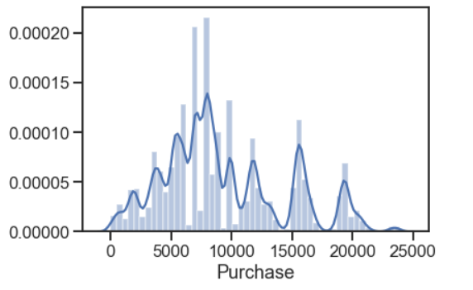
The Purchase trend graph shows us that most people purchased within the range of 5000 and 10000

Slide 8
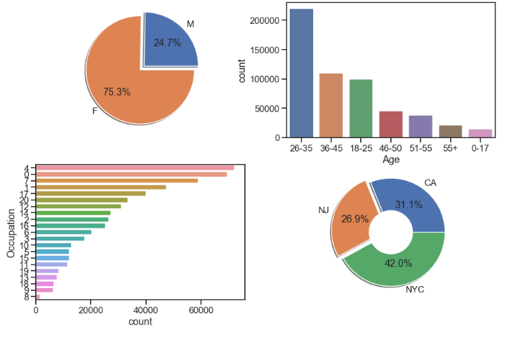
Visualization by Count
More no. of females than males did the shopping.
Age group of 26-35 tends to shop more than other age group.
Major Customers are from New York City while least are from NJ
Customers with occupation code 4 shops the most.

Slide 9
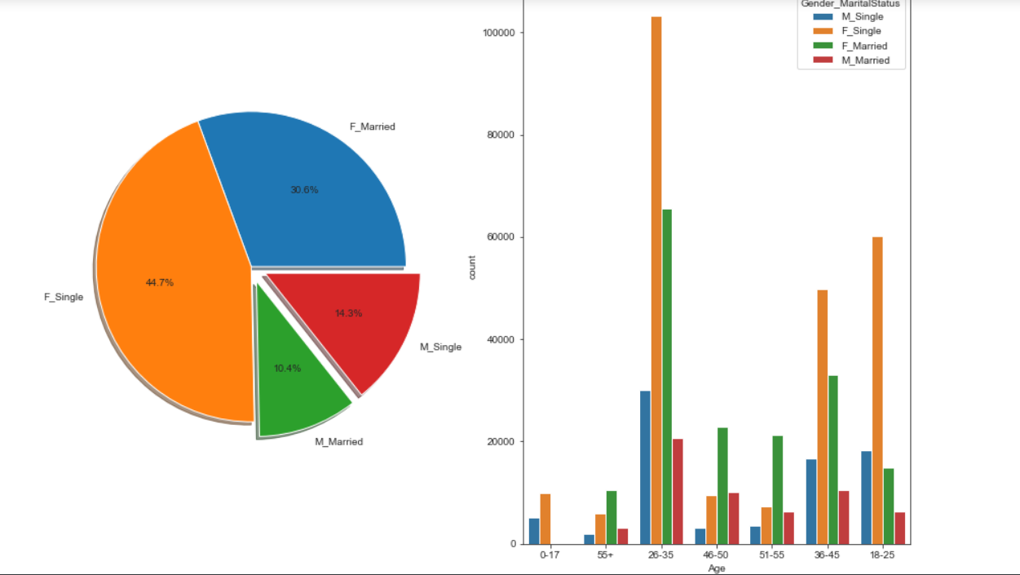
Single Females between the age group of 26-35 are major customers of the store.

Slide 10
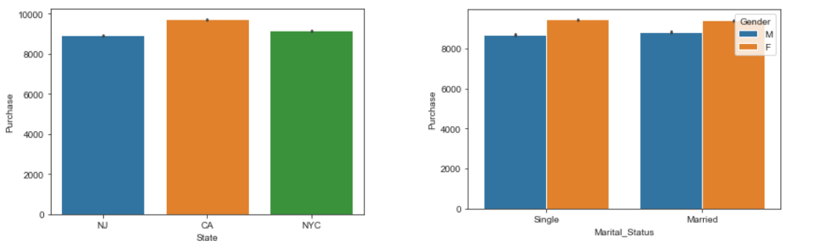
Customer in CA spend more money on their purchase than any other state.
Females either single or married tends to spend more on purchase than their male counter part.

Slide 11
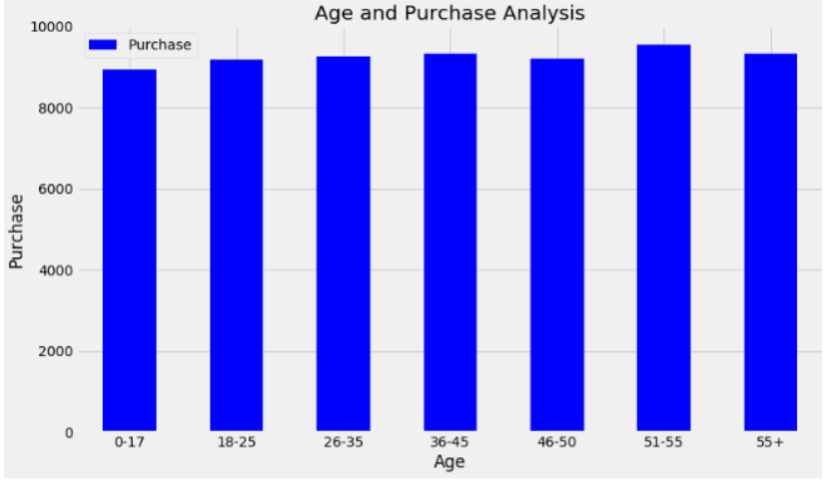
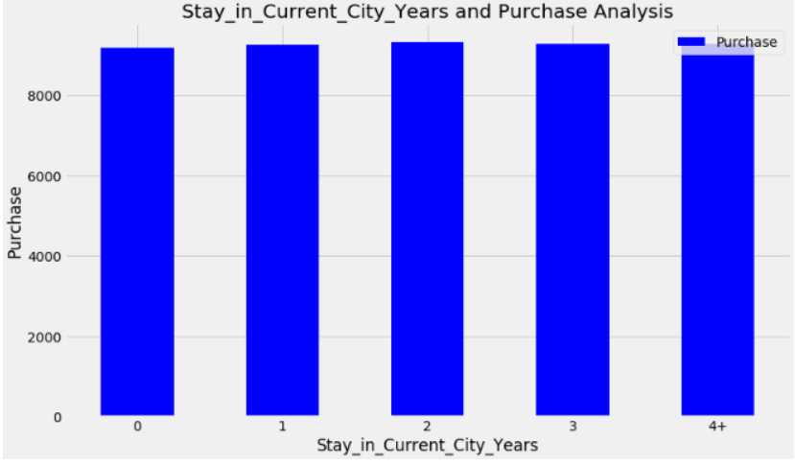
Amount spend is almost same by all age groups.
Despite the no. of years stay,equal amount is spend by the
customer.

Slide 12
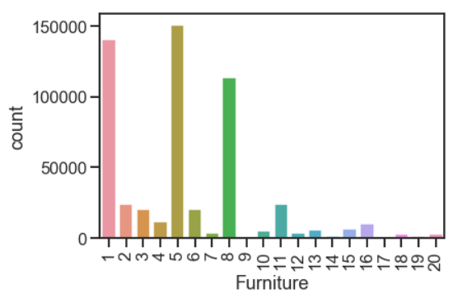
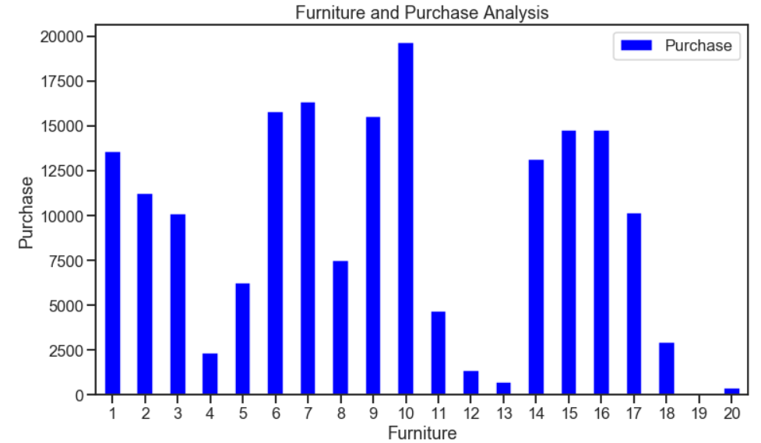
Furniture 1,5,8 have the highest sum of sales as shown above but the amount spent on those three is not the highest.

Slide 13
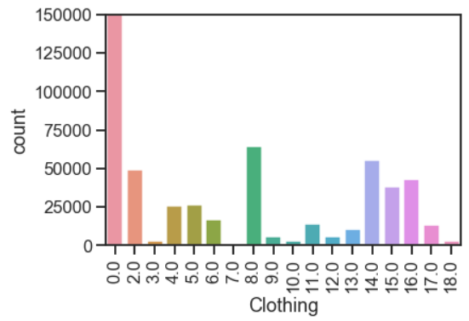
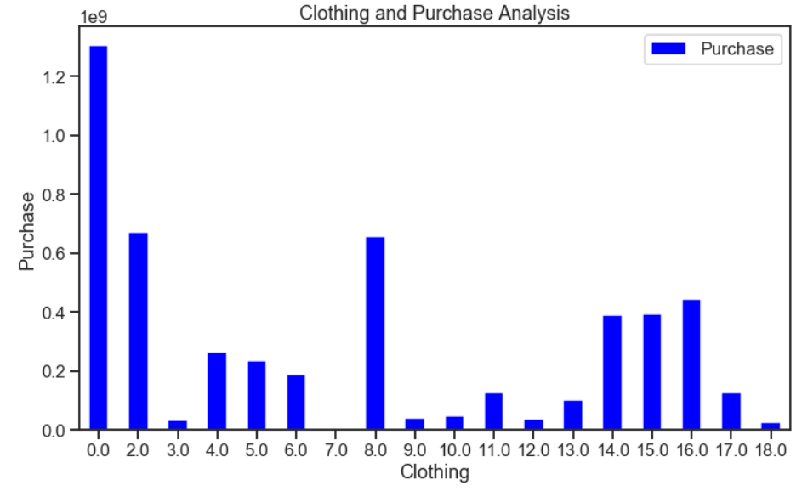
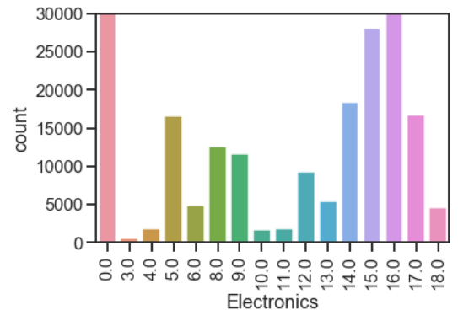
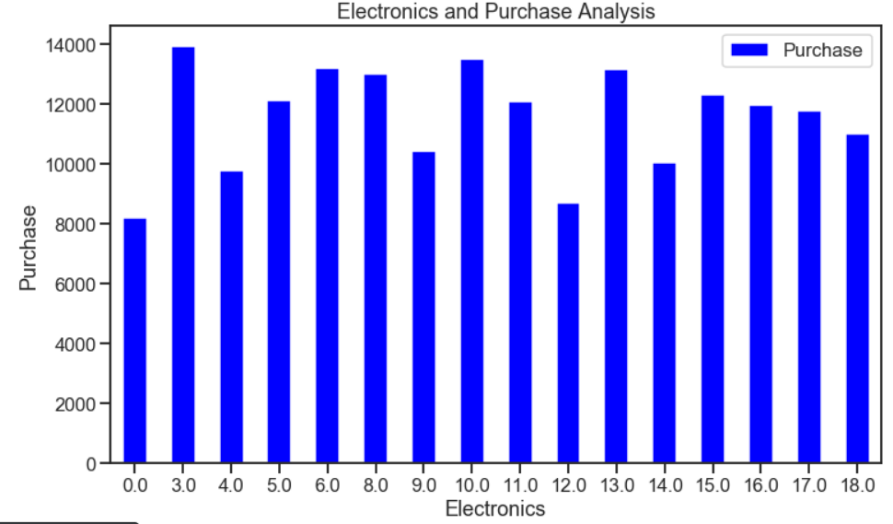

Slide 14
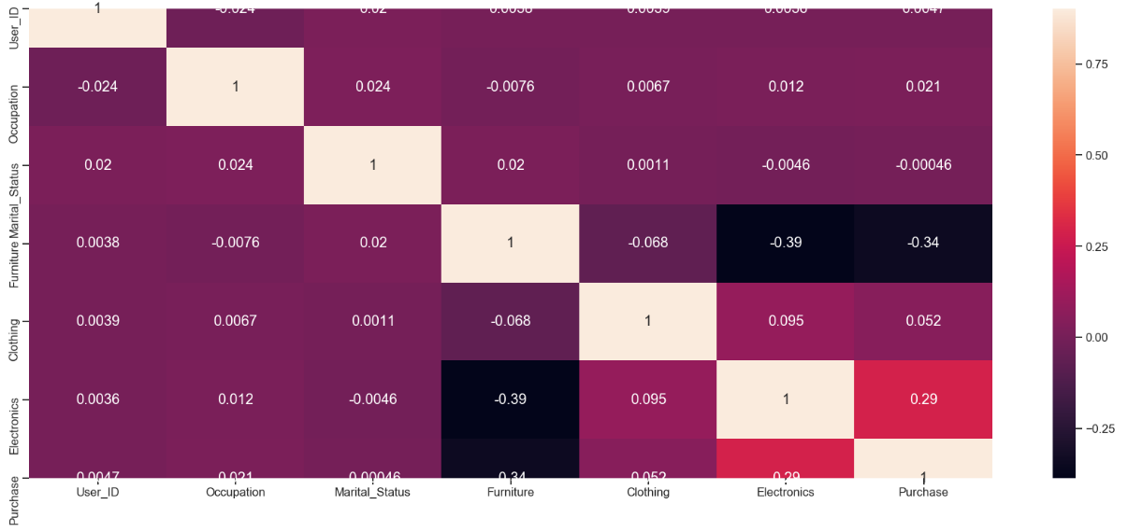
The heatmap is a way of representing the data in a 2-dimensional form. The data values are represented as colors in the graph. The goal of the heatmap is to provide a colored visual summary of information

Slide 15
Modeling

Slide 16
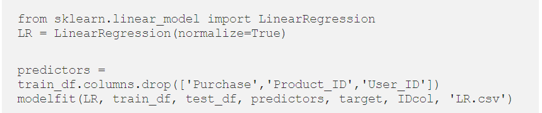
LINEAR REGRESSION MODEL

Slide 17
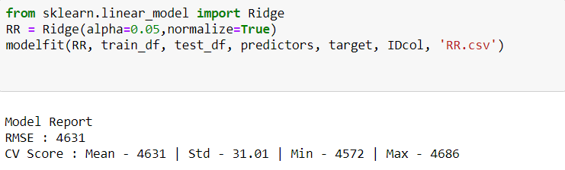
RIDGE REGRESSION MODEL

Slide 18
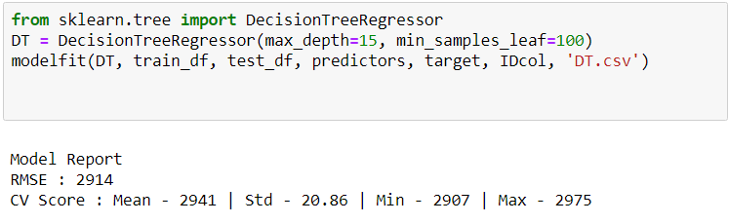
DECISION TREE REGRESSION MODEL

Slide 19
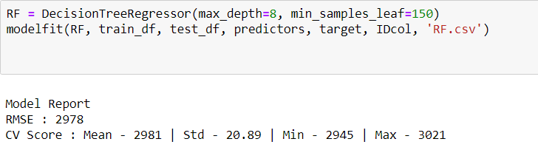
RANDOM FOREST REGRESSION MODEL

Slide 20
CONCLUSION
Based on the accuracy score and the RMSE score of the models, exploring prediction values using the best trained model.
RMSE score for Decision tree algorithm is observed to be minimal

Slide 21
Thank you.

